Slide 1

Marginal Efficiency of Capital
Principles of Macro Economics 1
ECONA 201

Slide 2
Marginal Efficiency of Capital
According to Stonier and Hague, “The marginal efficiency of any asset shows what an entrepreneur expects to be able to earn from acquiring one more asset of that kind compared with what he has to pay to buy it”.

Slide 3
Prospective Yield:
The prospective yield of an asset is the aggregate net return expected from its whole life.
PY = Q1 + Q2 +Q3……. + Qn
Supply Price:
Supply price of a capital asset is also called Replacement Cost.

Slide 4
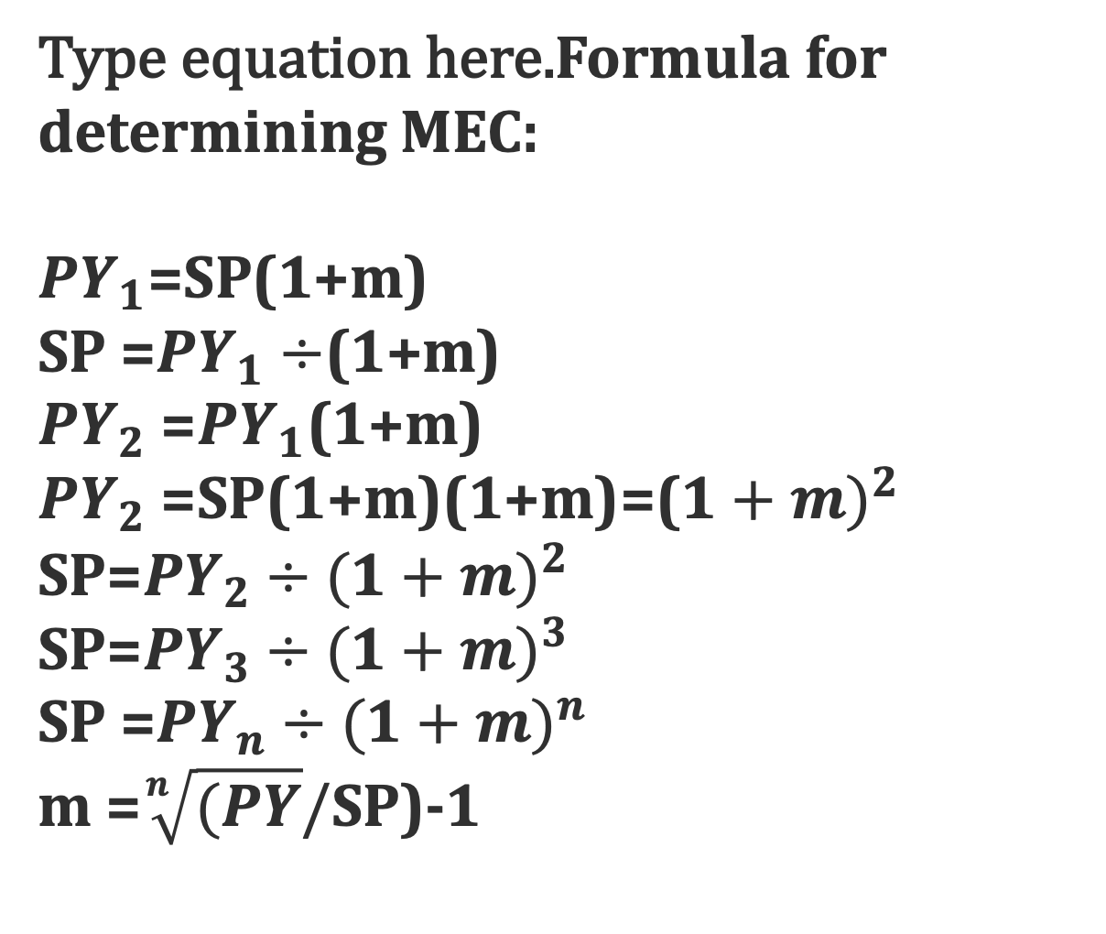
Formula for determining MEC:
${PY}_{1}$=SP(1+m)
SP =${PY}_{1}÷$(1+m)
${PY}_{2}$ =${PY}_{1}$(1+m)
${PY}_{2}$ =SP(1+m)(1+m)=(${1+m)}^{2}$
SP=${PY}_{2}÷{(1+m)}^{2}$
SP=${PY}_{3}÷{(1+m)}^{3}$
SP =${PY}_{n}÷{(1+m)}^{n}$
m =$\sqrt[n]{(PY}/$SP)-1

Slide 5


